Slide 1


Predicting Nightly Rates for Airbnb Listings in Boston
MGMT 68300
Group 5

Slide 2




Our Team
Prashanth Chari
Yukti Sanjay Jain
Ashvin Raj
Akshita Sharma

Slide 3

Business Problem Overview
Dynamic Market Challenges
Hosts in Boston might face difficulties setting optimal nightly rates due to fluctuating demand and competitive market conditions, risking revenue loss or low occupancy
Data Overwhelm
Hosts often struggle to effectively utilize vast amounts of market and customer behavior data, leading to suboptimal pricing decisions
Evolving Consumer
Expectations: Rapidly changing guest preferences in the post-pandemic era require hosts to adapt quickly, a challenge without sophisticated analytical tools
Notes:
In Boston's competitive market, Airbnb hosts grapple with setting nightly rates due to ever-changing demand, seasonal trends, and diverse guest preferences, risking revenue loss or low occupancy. Overwhelmed by abundant data on market dynamics and pricing, hosts often struggle to capitalize on this information, leading to indecision or ineffective pricing tactics. Moreover, evolving post-pandemic consumer expectations demand quick adaptation of services and pricing, a task that can be daunting without advanced analysis tools.

Slide 4





Objectives
Competitive Edge in a Dynamic Market
Guest Satisfaction and Reputation Management
Utilizing Technology for Informed Decisions
Adaptability to Market Dynamics
Optimizing Revenue through Accurate Pricing
Notes:
Our objective is to Strike the right balance between competitiveness and profitability in setting nightly rates for Airbnb listings in Boston which would Directly influences occupancy rates and revenue per booking, which is crucial for financial success. This not only influences occupancy rates but also plays a crucial role in guest satisfaction and reputation management, as fair pricing aligns with guest expectations and fosters positive experiences. Furthermore, adaptability to market dynamics, such as seasonal changes and local events, is essential for maintaining relevance and appeal. Lastly, utilizing technology, particularly data analytics and machine learning, is imperative for hosts to make informed pricing decisions, ensuring they stay competitive and successful in a constantly evolving market landscape.

Slide 5

Dataset Description
The Airbnb dataset for Boston contains a total of 47,606 records and 111 columns.
Among these columns are 8 categorical variables and 103 numerical variables, that including various types of data such as IDs, ratings, number of reviews, financial figures, and geographical data
Detailed information on Airbnb listings and host performance.
IDs for hosts and properties.
Location details and geographical data.
Property characteristics and booking specifics.
Host performance metrics and financial data.
Indicators: pet allowance, instant booking availability.
Notes:
Now lets check out the Airbnb dataset for boston, comprising 47,606 records and an extensive 111 columns. This rich dataset comprises a diverse range of information, from property details to host performance metrics. Within the dataset, we've identified 8 categorical variables and 103 numerical variables, offering a nuanced understanding of the Boston Airbnb landscape. The data spans from IDs for hosts and properties to crucial financial figures, ratings, and geographical details . Now lets perform some EDA to get meaning insights from data.

Slide 6
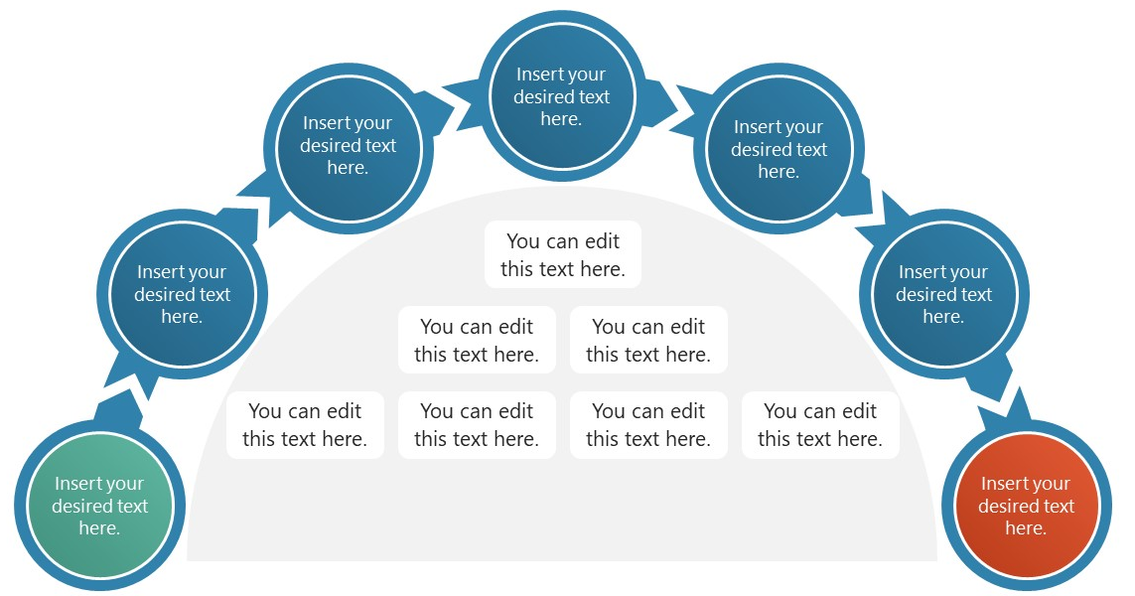
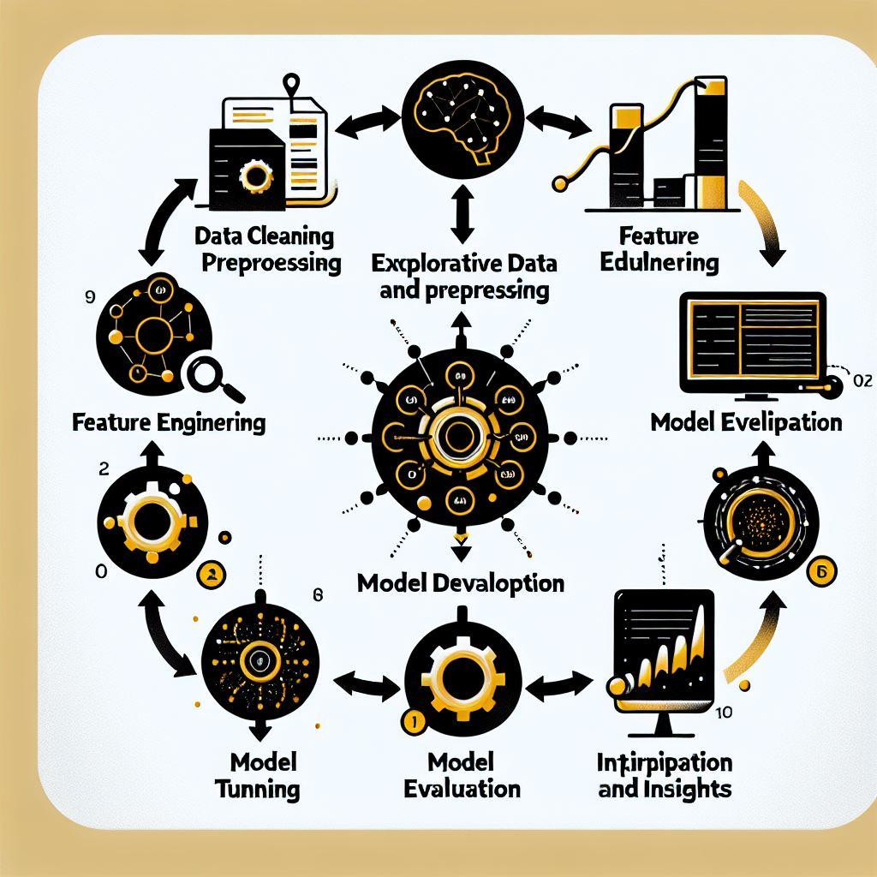

Process Overview
Exploratory Data Analysis (EDA)
Data Cleaning and Preprocessing
Feature Engineering
Model Development
Model Evaluation
Parameter tuning
Interpretation and Insights
Notes:
EDA - It is an important preliminary step in any data analysis or machine learning project. We have done this to analyze and investigate the dataset to discover patterns, spot anomalies, test hypotheses, and check assumptions before formal modeling, training, or evaluation.////
The next step is Data cleaning and preprocessing: Basically, real data is often messy and needs tidying up before using it in analysis. We clean it to fix issues like missing information or errors that would skew results. Pre-processing restructured the data to help the analysis tools make sense of it. We removed invalid outliers so only meaningful data is to be used. With preprocessing, we formatted. organized and arranged the dataset so it works better with the type of analysis being done. Kinda like organizing your room so you can find everything easily.////
Furthermore, Feature engineering is about remixing and reshaping the data into the most model-comprehensible format possible, revealing what would otherwise stay hidden among noisy variables. We guided the models by explicitly calling out the information that we, with our human intuition, know are the keys to the prediction task at hand. The newly engineered mix of features then served as a neatly packaged set for the models to consume. In short, we did feature engineering to preprocess raw data into its most model-friendly format to spoonfeed the key patterns to models so they can learn superior insights. The better the data, the better the predictions!////
Model development simplified - we build models to make accurate forecasts. Applying intelligent algorithms allowed analyzing massive data to uncover patterns that made reliable predictions possible. Choosing the optimal modeling technique was crucial to properly interpret the data and realistically represent the real-world system.////
In Model evaluation, thoroughly evaluating model performance judged how well predictions matched truth. Verifying a model's ability to generalize ensured the patterns learned enable realistic forecasts, not just historical overfitting. Rigorously testing across appropriate metrics provides confidence in deployment, allowing models to automate decisions knowing they will continue operating reliably.////
In Parameter tuning, we tuned modeled parameters like shrinkage, tree sizes and regularization strength to find the optimal configuration that resulted in the highest predictive accuracy on validation data. Tuning counterbalanced under and overfitting thus was a key step.////
Lastly, we interpreted models to translate influential patterns into tangible business metrics like moentary impact of types of listings. Connecting predictions with commercial outcomes allows optimizing decisions around areas like pricing and overall strategy.////
In the next slide, I will take you through the EDA done for our target variable nightly_rate.////

Slide 7
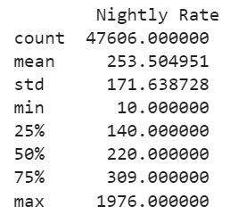
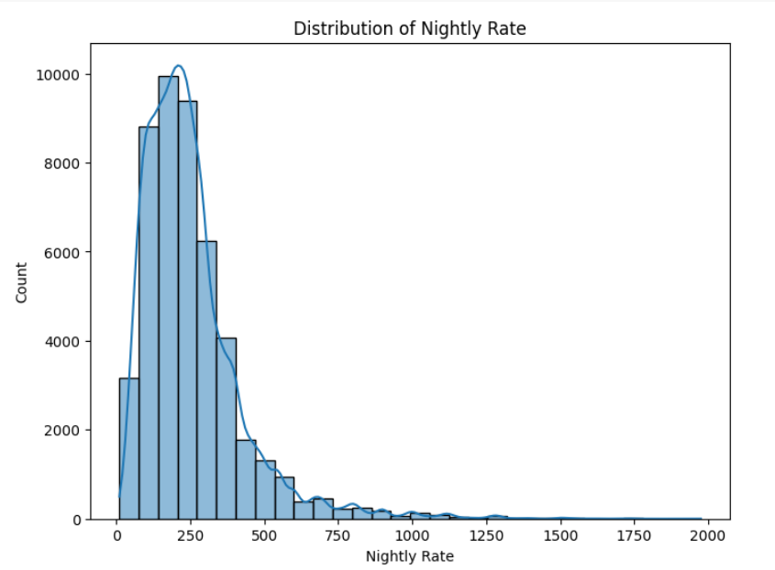
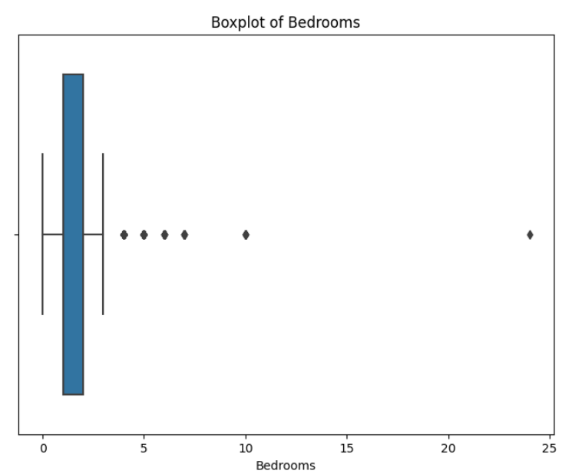
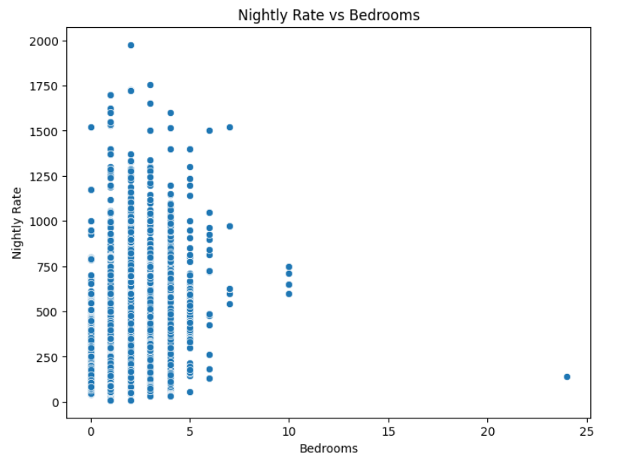
Exploratory Data Analysis (EDA)
Summary Statistics of the target variable (Nightly Rate) Distribution of Nightly Rate
Boxplot of Bedrooms Nightly Rate vs Bedrooms
Notes:
Summary statistics- count, mean, std and so on////
Distribution- skewed hence not normal distributed////
Boxplot- outlier identification
Nightly rate vs bedrooms: outlier confirmation and removal

Slide 8
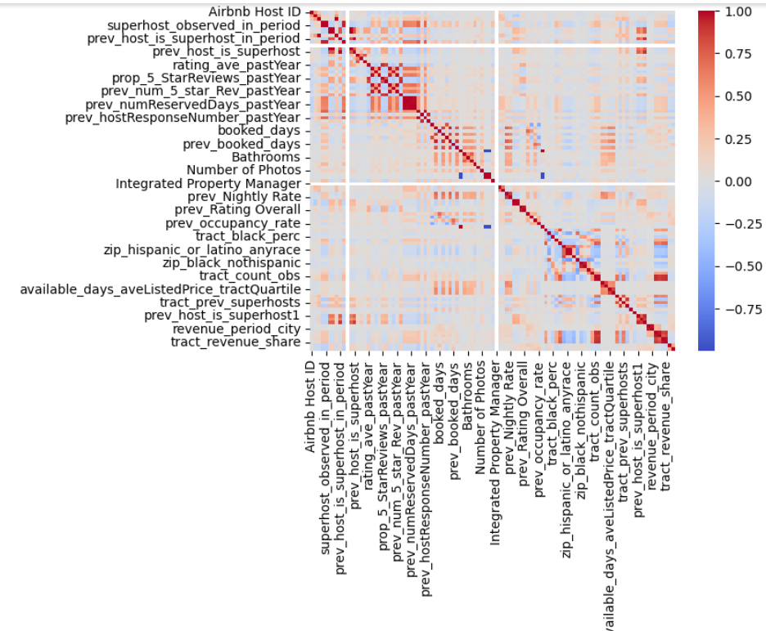
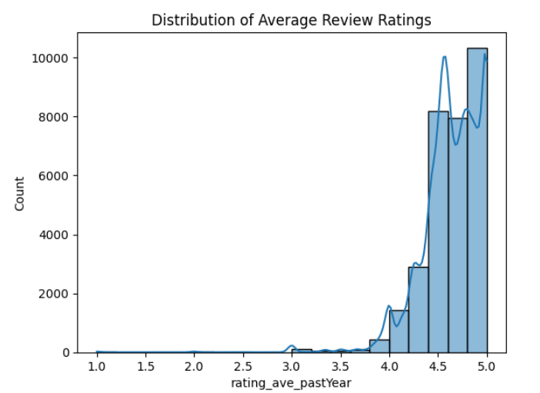
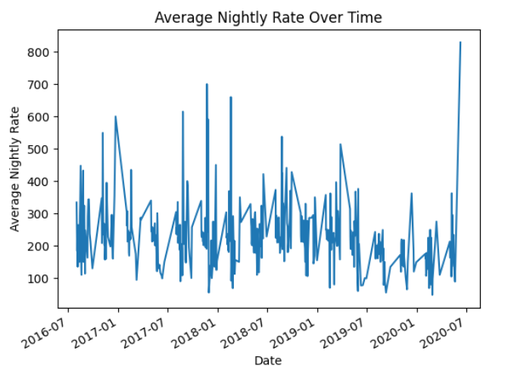
Exploratory Data Analysis (EDA)
Correlation Matrix Distribution of Average Review Ratings
Average Nightly Rate
Notes:
Correlation matrix
Distribution of ratings
Average nightly rate for various time periods – fluctutations

Slide 9


Data Cleaning and Preprocessing
Outlier Treatment
Handling Missing Values
Preprocessing Relevant Data
Detected data points that significantly skewed the dataset, leading to impractical scenarios.
For instance, a data point featuring 25 bedrooms with a nightly rate lower than that of a one-bedroom apartment.
Dropping Rows : Eliminated rows with missing bedroom data to ensure data integrity.
Imputing Missing Values:
a) Categorical Data: Employed the mode for imputing missing values in categorical data.
b) Geospatial Imputation: Additionally, imputed neighborhood values based on the corresponding zip code.
Recognized columns highly correlated with the target variable.
Excluded unnecessary columns from the analysis; for instance, prev_nightly rate was highly correlated with nightly rate but omitting it prevented biased model results.
One-hot encoded categorical variables (Property Type, Listing Type, Neighborhood)
Notes:
Outlier treatment- example from earlier, spotted through EDA////
Handling missing values- bedroom missing values – dropped rows
Imputing- for categorical, we applied imputing to fill in the missing values. We used mode for categorical variables. For neighborhood, we used zipcodes to impute the corresponding values////
Preprocessing- using correlation, recognized highly correlated columns to exclude unrequired fields from analysis. For example, we realized that prev_nightly rate was highly correlated with our target variable, hence removed it to reduce bias.////
We employed onehot encoding techniques to convert categorical to numerical data for model training and subsequent analysis. A few features include property type, listing type, neighborhood and so on.////
We will now move on to the next step- feature engineering, that will be covered by Ashvin.

Slide 10
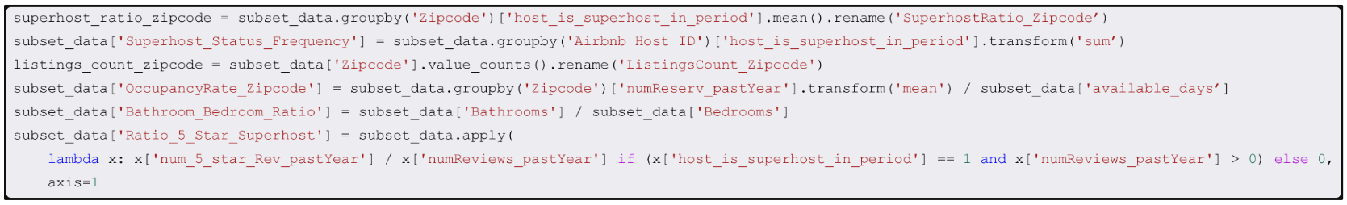
Feature Engineering
SuperhostRatio_Zipcode: Reflects the concentration of quality hosts in an area, influencing perceived value and price.
Superhost_Status_Frequency: Indicates host quality and reputation, affecting listing desirability and pricing power.
ListingsCount_Zipcode: Measures market saturation, which can impact pricing through supply and demand dynamics.
OccupancyRate_Zipcode: Signals area demand, informing potential rate setting based on local popularity.
Bathroom_Bedroom_Ratio: Suggests property comfort level, potentially justifying higher rates for greater convenience.
Ratio_5_Star_Superhost: Combines guest satisfaction with host status, which can correlate with higher achievable prices.
Notes:
calculates a ratio of 5-star reviews to total reviews for each listing in the DataFrame, but only if the host was a superhostin the period and if there were any reviews. If these conditions are not met, the ratio is set to 0. This metric could be useful for understanding the quality of listings provided by superhosts.

Slide 11
Models Chosen and Why?
Lasso Regression
For better model interpretability that helped us analyze business impact
Selecting features from gradient boosting, including interaction terms and refining using lasso shrinkage further increased accuracy
Coefficients gave us the monetary impact of the most significant features filtered by the model
Gradient Boosting:
For selecting significant variables based on feature importance
For predicting nightly rates based on the selected predictors, that can be used by the hosts for competitive edge
Higher model accuracy that withstands inconsistencies in real world data
Our approach optimizes model accuracy for robustness and interpretability for analyzing business impact
Validation R-squared: 0.68
MAPE ~ 16.83%
Train-test : Prediction – 85 : 15
Train : Test – 80 : 20
R-squared – 0.76 MAPE ~ 10%
Prediction R-squared: 0.72
Correlation of prediction vs actual night rate 0.9
Notes:
Speak about why Backward Selection was discarded.

Slide 12
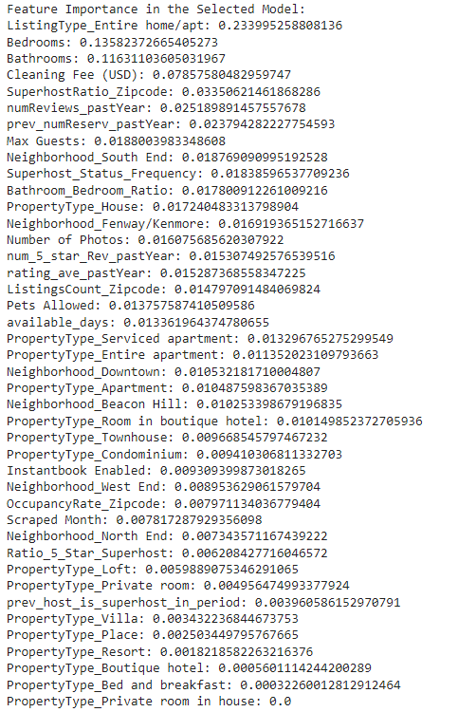
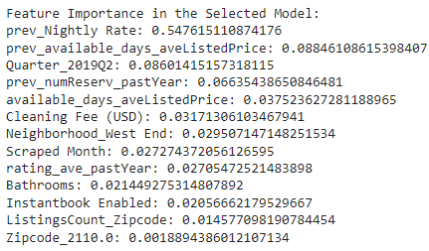
Gradient Boosting
Selecting the most important features
Excluding variables correlated to pricing or “Nightly Rate” steers the model to assess actionable host-controlled factors, guiding strategy improvements rather than mirroring past prices.
Omitting direct pricing variables avoids circular logic, ensuring the model's insights reflect genuine market influences on pricing decisions.
Feature importance analysis identified key determinants of nightly rates for Airbnb listings in Boston. The top features influencing pricing decisions include:
Notes:
Focus on Actionable Metrics: By excluding direct pricing variables like 'prev_Nightly Rate', the model shifts focus towards factors that are within the host's control, such as amenities offered, service quality, or booking policies. This helps in identifying levers that can be actively managed to enhance competitiveness and profitability, rather than simply relying on historical prices which might not reflect current market dynamics or the host's potential to improve their offering.
Avoiding Circular Reasoning: Including 'prev_Nightly Rate' as a predictor could lead to a self-fulfilling prophecy where the model might overemphasize the influence of past pricing on future rates, neglecting how other variables might independently affect pricing. Removing it prevents the model from circular reasoning and ensures that the derived insights are based on intrinsic property features and market conditions that genuinely affect a guest's willingness to pay.
Listing Type, particularly entire homes or apartments, reflecting a higher value placed on privacy and space.
The number of Bedrooms and Bathrooms, indicating a direct correlation between property size and pricing.
Cleaning Fees, illustrating how operational costs are factored into nightly rates.
Superhost Status within a Zipcode area, signaling the impact of host quality on price competitiveness.
Review-related metrics, such as the number of reviews in the past year and the proportion of 5-star reviews for superhosts, underscoring the role of guest feedback in price setting.
Availability factors like the number of days listed and reservation history, showing the balance between demand and supply in price determination.

Slide 13
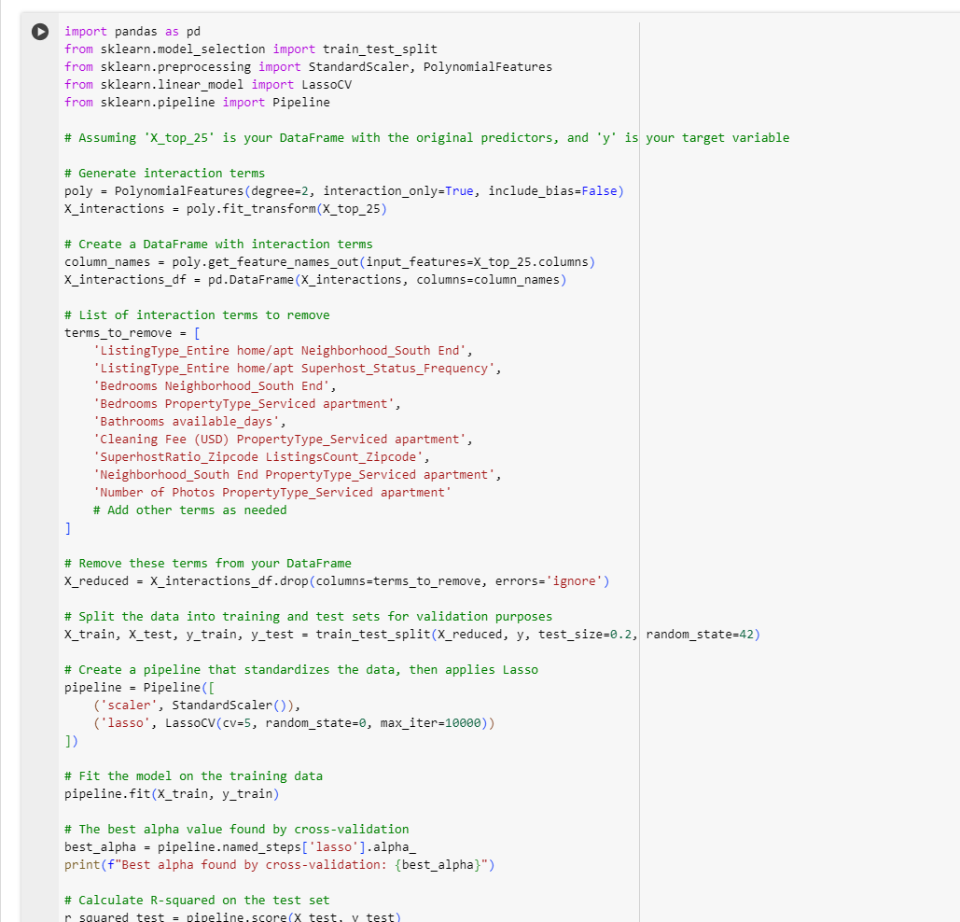
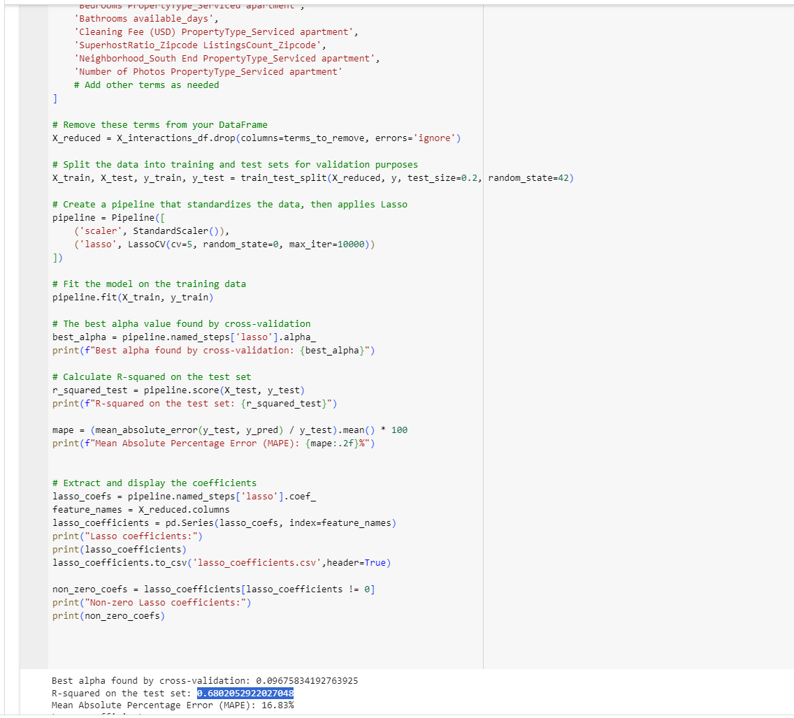
Lasso regression

Slide 14

Pricing Analysis
Nightly Rates:
The difference between predicated nightly rates and actual nightly rates was calculated for each neighborhood, revealing variations across regions.
Overpriced Neighborhoods:
The analysis identified several neighborhoods where the average nightly rates exceed the overall average. Notable overpriced neighborhoods include Back Bay.
Underpriced Neighborhoods:
Conversely, some neighborhoods display lower average nightly rates, indicating potential opportunities for travelers. Downtown falling into this category.
airbnb

Slide 15
Recommendations:
Pricing Adjustments:
Property owners in overpriced neighborhoods might consider adjusting their rates during high-demand seasons to remain competitive.
Marketing Strategies:
Owners in underpriced neighborhoods could leverage their pricing advantage in marketing campaigns to attract cost-conscious travelers.
Limitations:
Data Scope : The analysis is based on available data and assumes that nightly rates accurately reflect property value.
External Factors : External factors such as local events, festivals, or economic conditions were not considered in this analysis.
Notes:
Post our analysis, we have the following recommendations for hosts:
Pricing Adjustments: Property owners in overpriced neighborhoods should consider flexible rate adjustments during peak seasons, ensuring competitiveness in high-demand periods.
Marketing Strategies: For owners in underpriced neighborhoods, leverage your pricing advantage in marketing. Showcase affordability to attract cost-conscious travelers seeking value.
There are certon limitations to our analysis:
Firstly, the Data Scope: its imparitive to know that , our analysis relies on available data, assuming nightly rates accurately reflect property value.
Finally, the External Factors: Note that external factors like local events, festivals, or economic conditions weren't considered. These can influence pricing dynamics.
In conclusion, these insights aim to guide strategic decisions in a dynamic Airbnb landscape.

Slide 16
Key Take-aways from Lasso Model
Interaction Terms:
Entire homes/apt attract higher rates (+$19.22).
House listings tend to be priced lower
(-$24.04).
Consider bathroom-bedroom ratio for optimal pricing (-$30.46).
Quality photos positively influence rates (+$23.47).
More guests in entire home/apt listings reduce rates.(-$18.51)
Cleaning fee impact amplified by the number of bedrooms.($40.29)
Higher super host ratios positively affect rates with increased guests, basically , in the areas having more super hosts, having more guest increases the nightly rate. ($21.21)
Notes:
As mentioned , we used lasso model to effectively identify how varying each factor can affect the nightly rate. I will walk you through some variable combinations that can afftect the nightly rate:
First , ListingType_Entire home/apt: 19.22165377 - Listings categorized as entire homes or apartments are associated with an average increase of about $19.22 in the nightly rate compared to other listing types, assuming all other factors are constant. This could be attributed to people wanting privacy and reluctance to share housing with strangers.
Second, PropertyType_House: -24.0439716: In certain areas, apartments or other property types might be more centrally located or in higher demand than houses, thus commanding higher prices.
Third the interaction term of ListingType_Entire home/pt and Max Guests: -18.50663936: This interaction term combines the type of listing (entire home/apt) with the maximum number of guests it can accommodate. The negative coefficient suggests that for entire homes or apartments, a higher guest capacity is associated with a lower nightly rate. This might seem counterintuitive, as larger properties usually command higher prices. However, it could indicate that hosts of larger properties set lower per-person prices to attract bigger groups, or it might reflect a market where bigger properties are in less demand, leading to competitive pricing. Hosts of larger properties might need to consider their pricing strategy carefully. They may decide to focus on attracting larger groups with competitive pricing or explore ways to increase value (e.g., additional amenities or services) to justify higher rates.
Fourth, Bedrooms Cleaning Fee (USD): 40.28746888
This term represents the interaction between the number of bedrooms in a listing and the cleaning fee charged. The positive coefficient suggests that listings with more bedrooms and higher cleaning fees have higher nightly rates. This could reflect the reality that larger properties (with more bedrooms) require higher cleaning fees and are often priced higher due to their size and capacity.For hosts, this emphasizes the importance of setting appropriate cleaning fees for larger properties. It also indicates that guests may be willing to pay more for larger spaces, considering the associated higher cleaning costs.
Finally, Bathroom to Bedroom ratio: Market Preferences: In certain markets, guests might not value having extra bathrooms as much as other amenities, leading to a lower willingness to pay for higher bathroom-to-bedroom ratios. We can also look at it through property type angle as Higher bathroom-to-bedroom ratios might be more common in certain types of properties (like apartments or studios) that are generally cheaper than larger homes with more bedrooms.
So hosts can employ Efficient Use of Space: Listings that maximize bedrooms (and thus sleeping capacity) over the number of bathrooms might appeal more to larger groups looking for value, thereby commanding a higher nightly rate.

Slide 17
Conclusion
Hosts/Property Owners
Hosts can set competitive prices that increase occupancy rates and revenue, leading to a higher return on investment.
Airbnb Platform
Accurate pricing maximizes bookings, directly impacting Airbnb's commission-based revenue and enhances customer satisfaction
Customers
Customers benefit from clear and reasonable pricing, enhancing trust and engagement with the Airbnb platform.
Impact for Stakeholders
Location-Based Pricing
Properties in sought-after areas such as Beacon Hill and Fenway/Kenmore command higher rates, reflecting their high demand.
Influence of Features on Pricing
Factors like instant booking availability and the number of photos listed significantly affect nightly rates
Dynamic and Responsive
The model is capable of adjusting to seasonal trends, major events, and changing travel patterns, facilitating flexible pricing strategies
Business Insights
Notes:
In the evolving Airbnb market, hosts will increasingly benefit from sophisticated pricing strategies that maximize occupancy and returns. The platform will thrive on refined pricing algorithms, driving more bookings, increasing commission-based revenue, and improving customer satisfaction, thereby enhancing its brand loyalty. Customers will appreciate transparent and fair pricing, contributing to their trust and loyalty. Pricing strategies that take into account location demand, instant booking availability, and the appeal of property listings will continue to be essential. Adapting prices in response to seasonal trends and local events will be key to maintaining a competitive advantage and optimizing revenue year-round.

Slide 18
Extra Slides

Slide 19
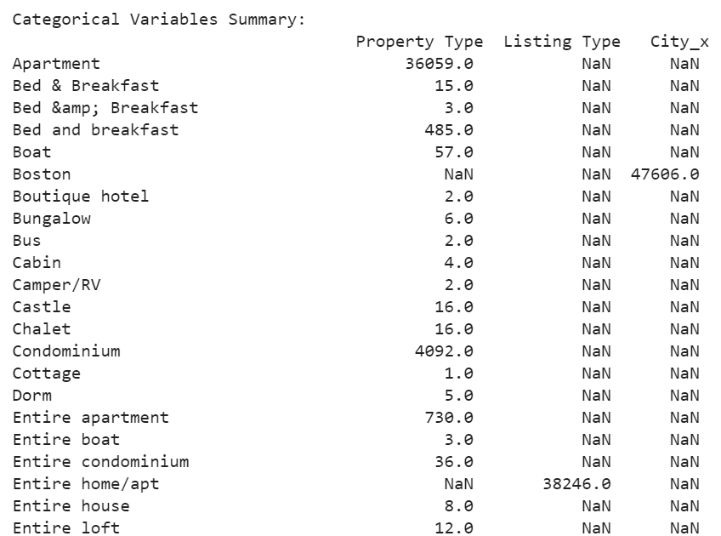
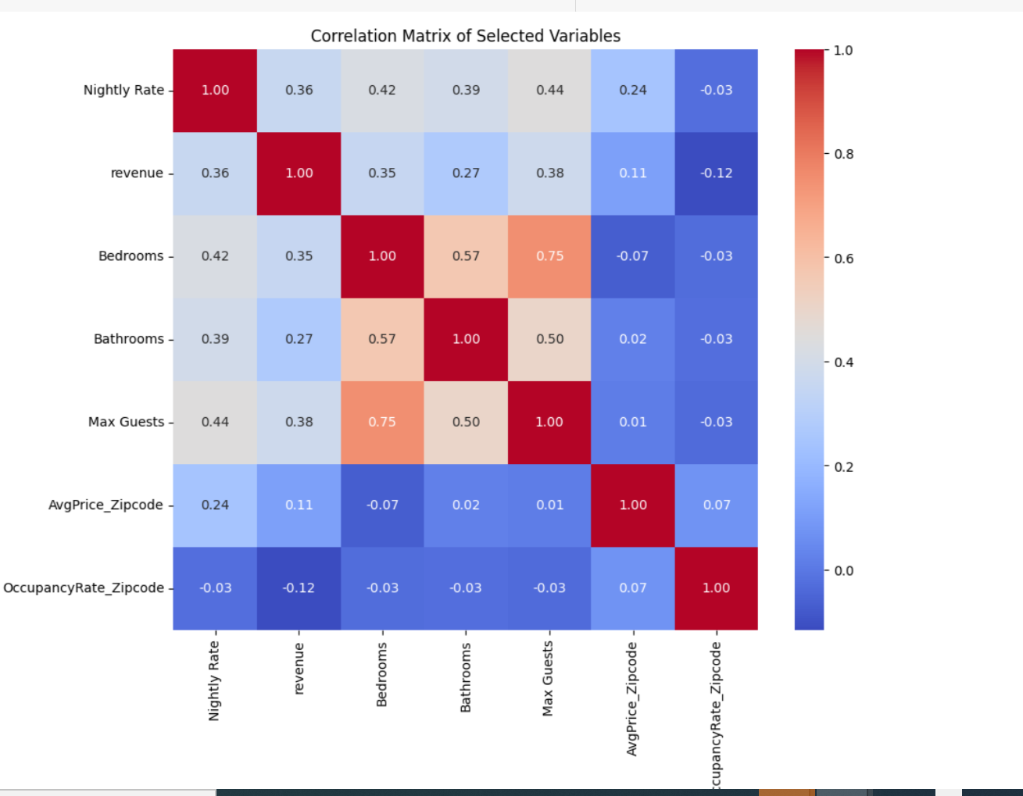
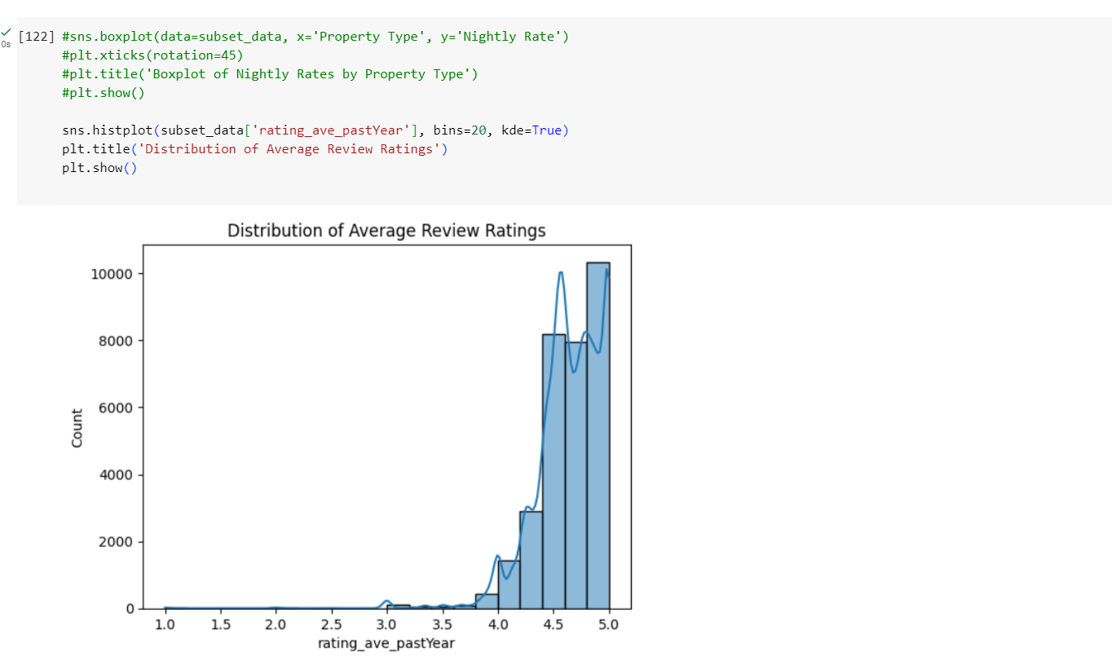
EDA (Extra)
Subhead, Franklin Gothic 22

Slide 20
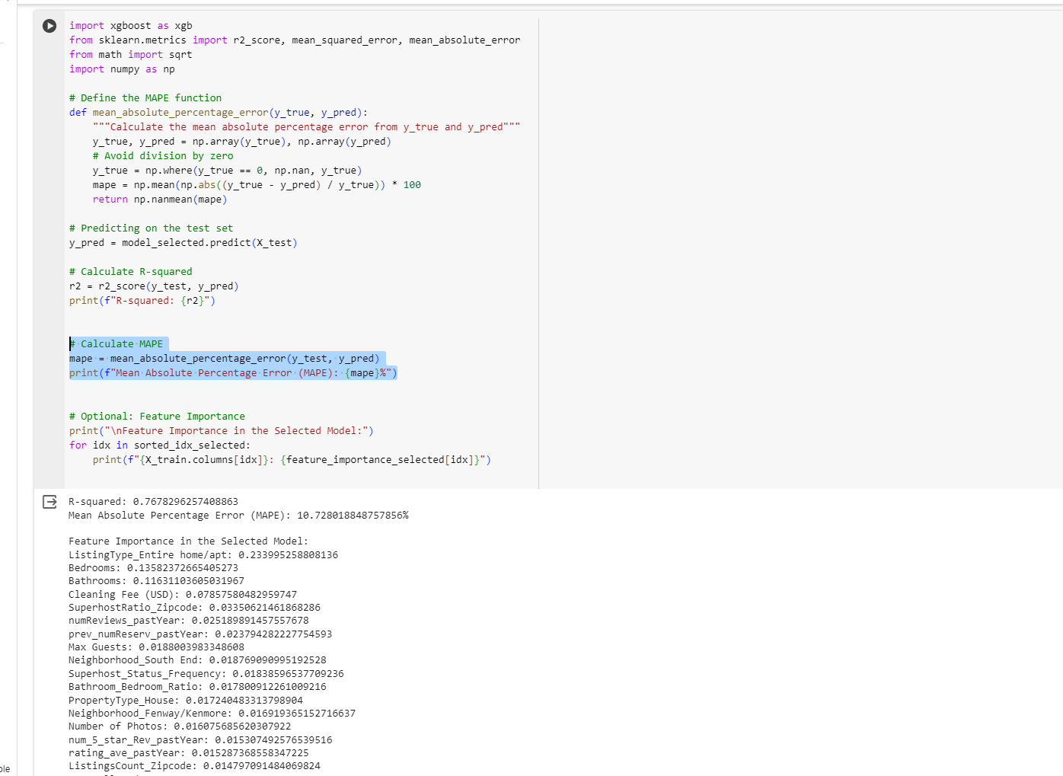
R^2 and MAPE score for the gradient boosting model

Slide 21
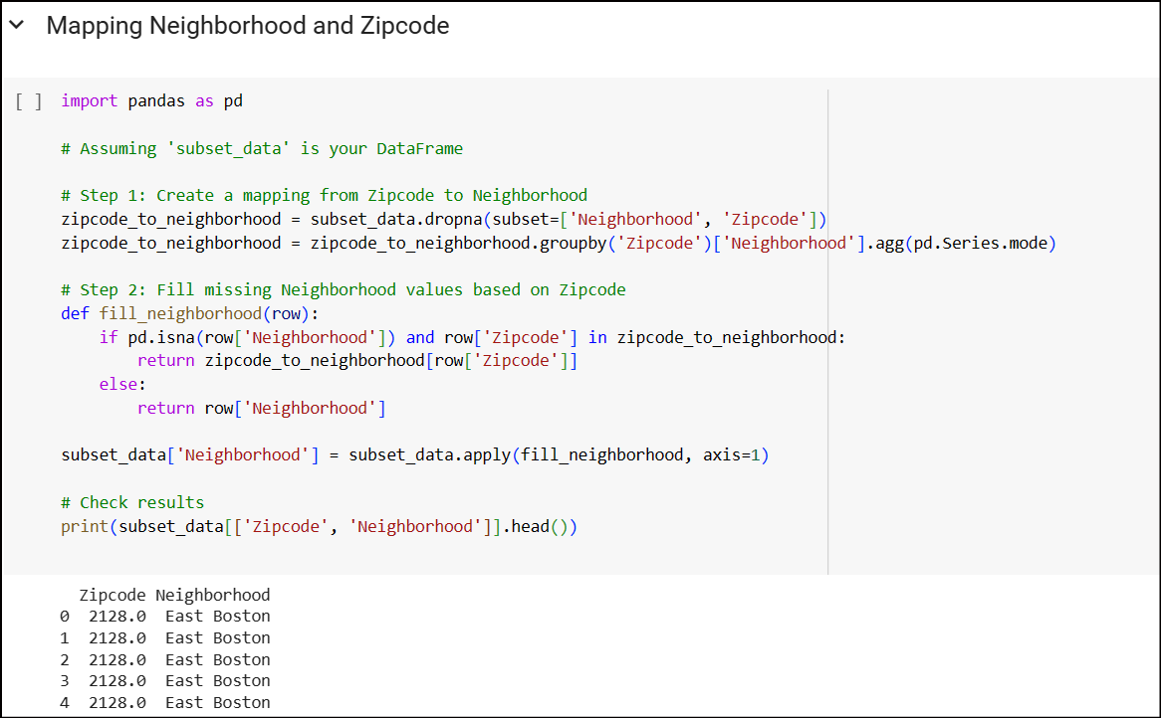
Data pre-processing: imputing 'Neighborhood'

Slide 22
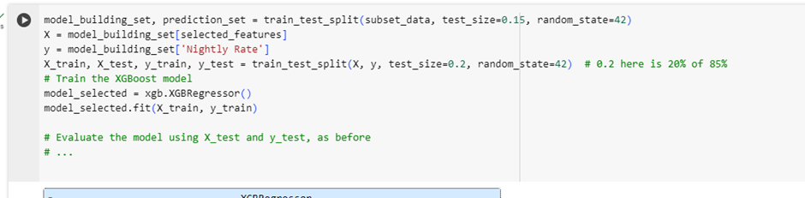
Data Splitting for Model Training and Testing and Prediction

Slide 23
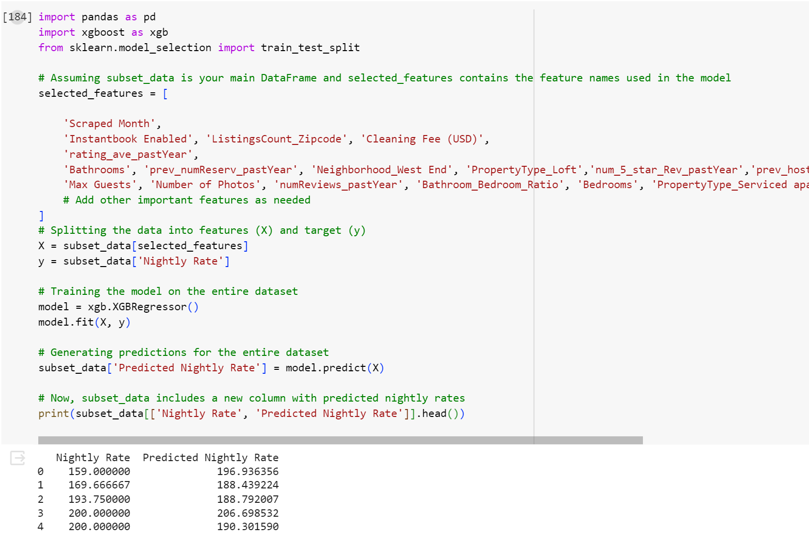
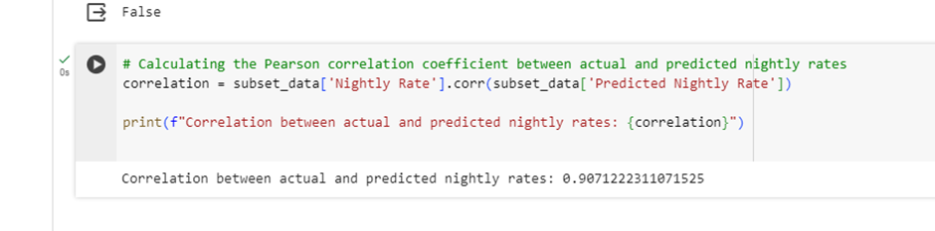
Nightly rate vs Predicted Nightly Rate

Slide 24
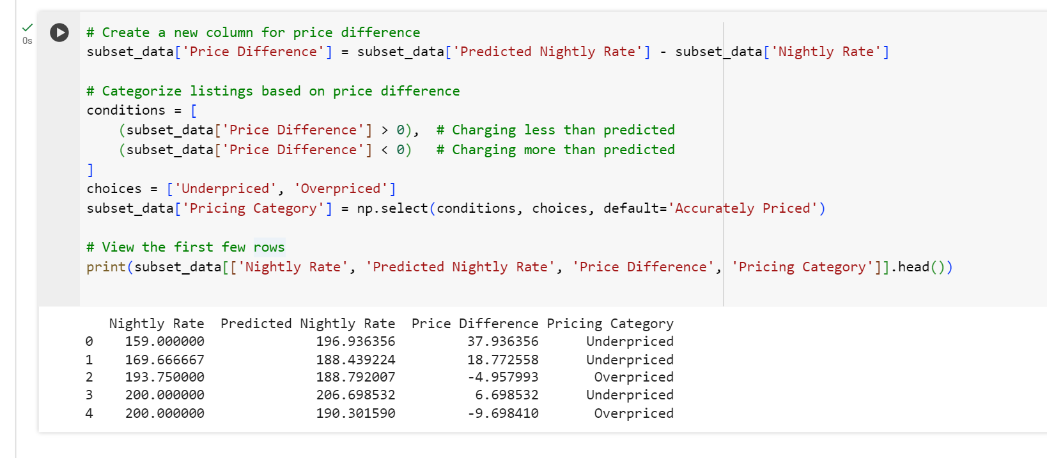
Over priced vs Under priced

Slide 25
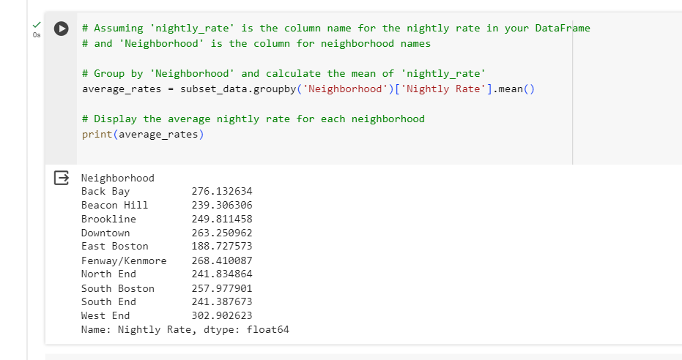
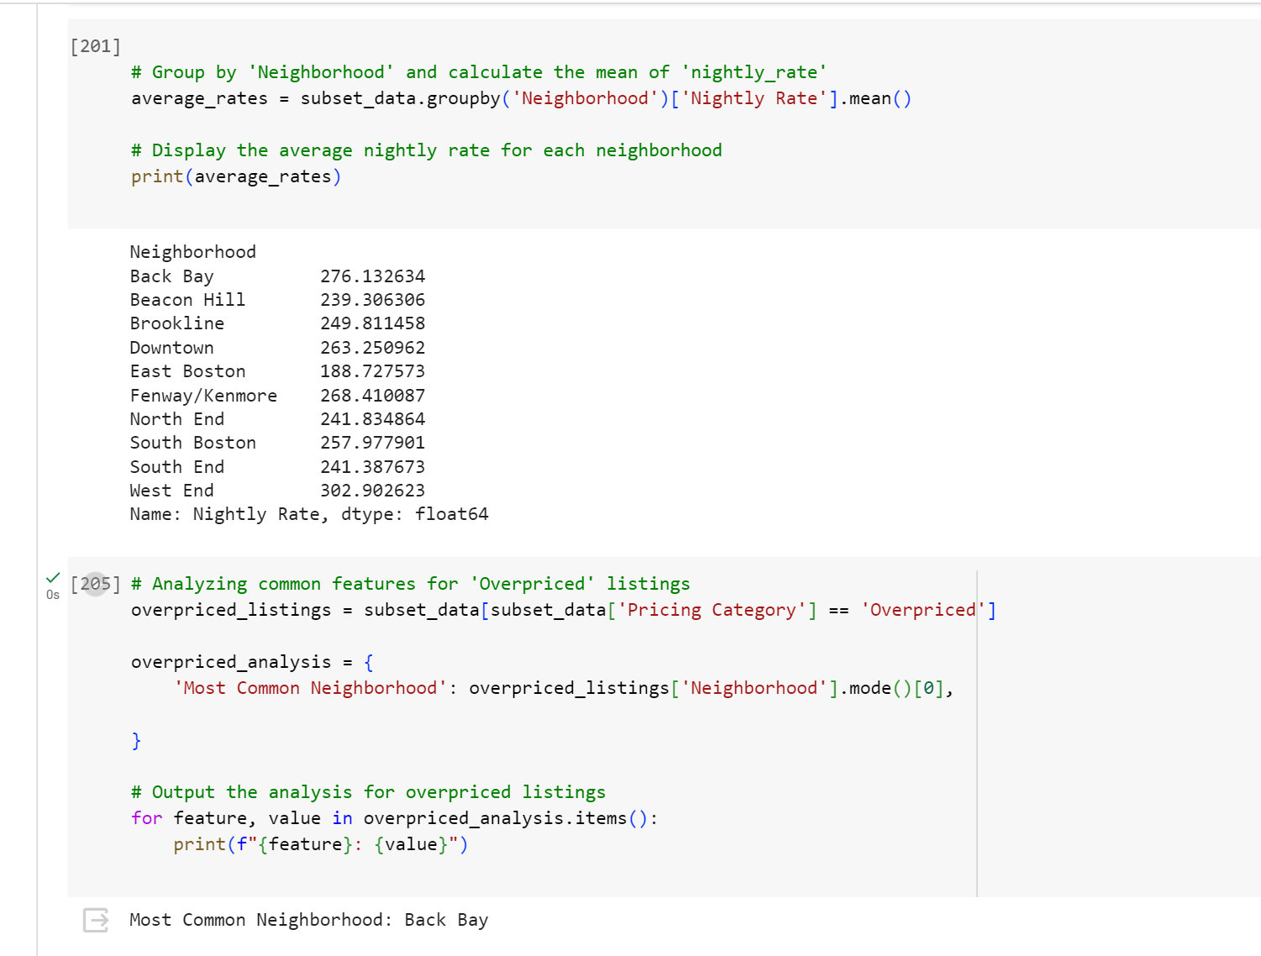
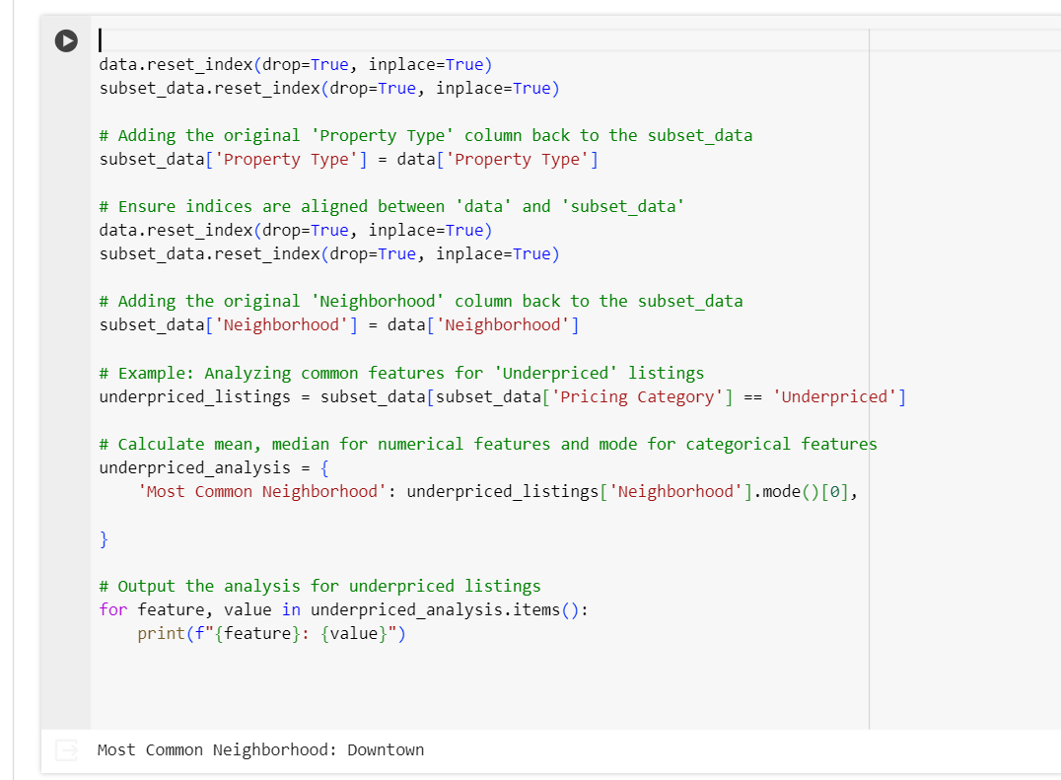
Downtown vs Back Bay
https://www.fodors.com/community/united-states/best-location-to-stay-when-visiting-boston-back-bay-or-downtown-927274/

Slide 26
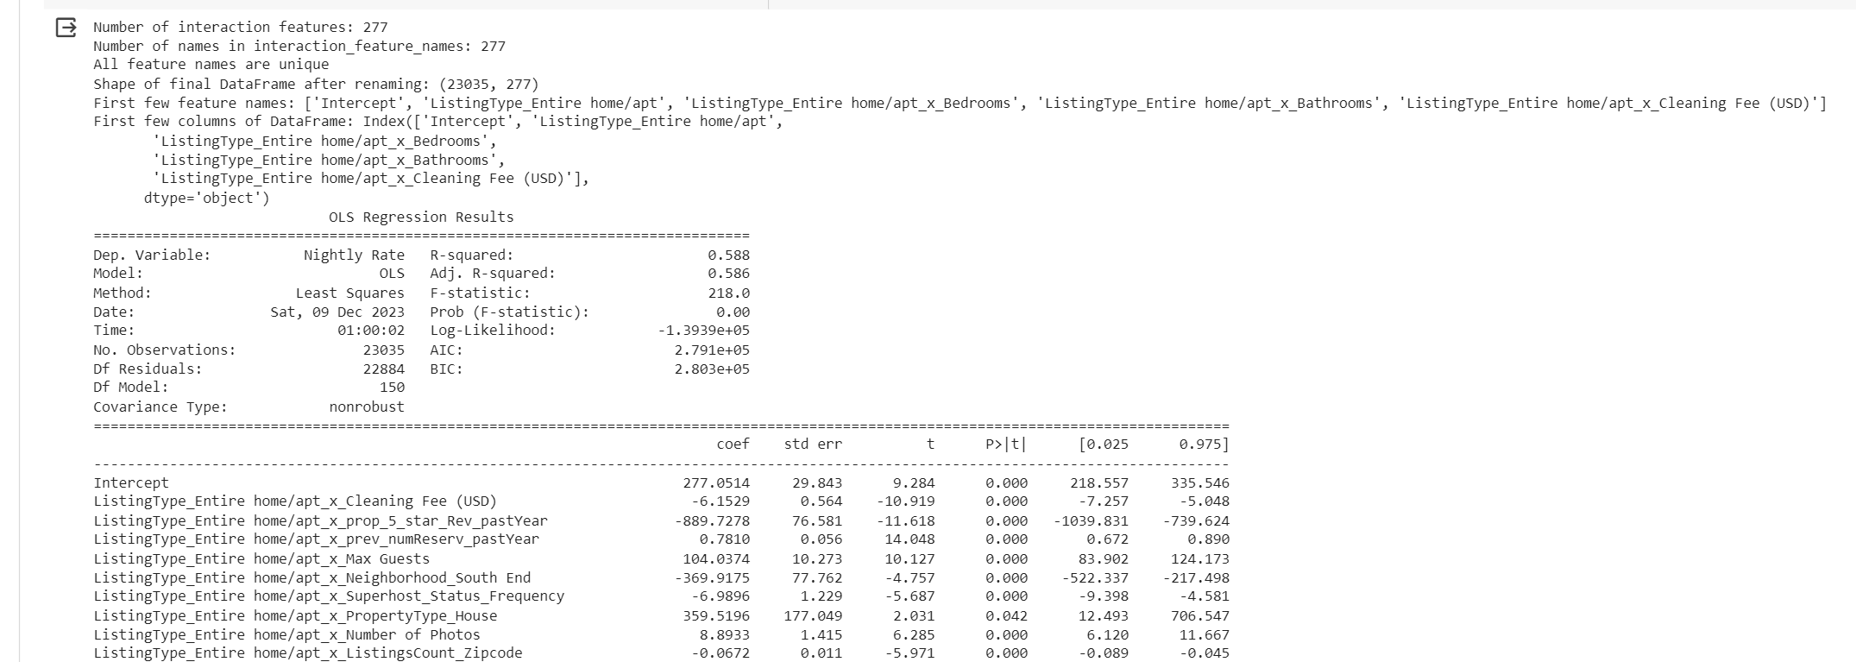
Backward Selection Model Tried

Slide 27
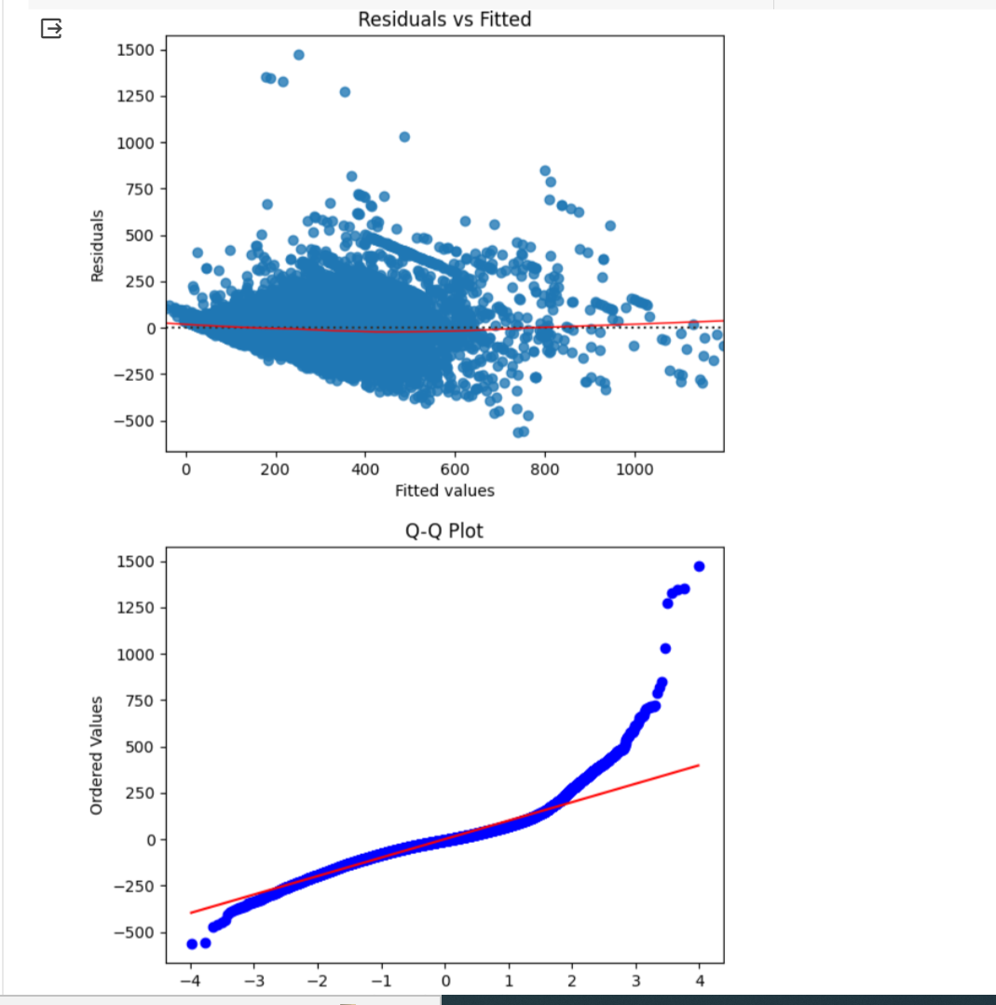
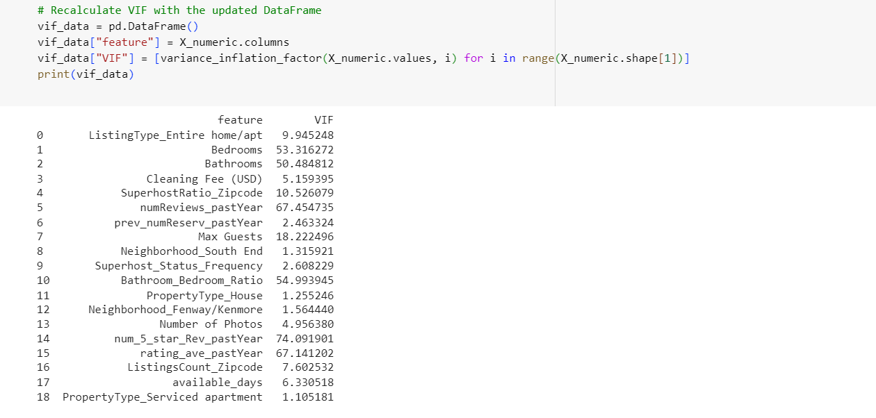
Backward Selection Model indicating high VIF

Slide 28
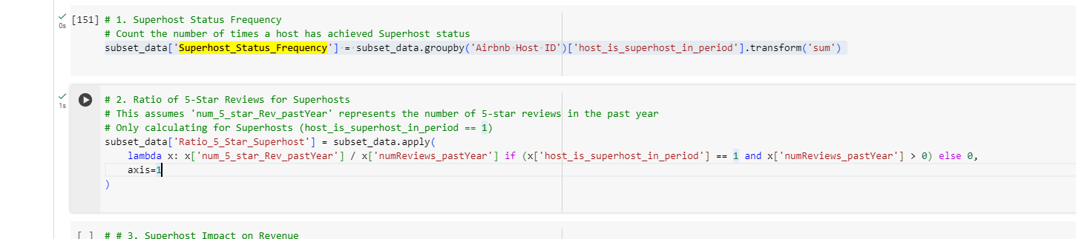
Feature Engineering

